Slide 1
OnDemand professor Q&A Bot
Problem title: Q & A bot for Network security Documents
Group name: Group 2
Sreevidya Bheemagunta R11903527
Sheshi Sree Sama R11907192
Neha Bollu R11903528
Vikram Sai Pavan Beesabattini R11909782
Kalyani Chittipolu R11909106

Slide 2
Project statement
The main goal of this project is to produce a secured and privacy Q & A bot for Network security course. Unlike other bots, our bot is exclusively on local machine.
Our bot is capable of answering questions which are related to network security course.

Slide 3
User-Friendly Interface:
Our bot is a user friendly interface which provides a user-friendly interaction. Users can easily give the input questions and bot gives accurate and relevant answers
It prioritize’s privacy of the data by keeping all information on local machine.
Data in bot is stored locally to eliminate internet issues.
Bot is specialized in providing answers related to Network security documents.

Slide 4
Proposed Solution:
Introduction:
Create a Q&A Chatbot, for network security that prioritizes data privacy by storing all information on the system. The Chatbot will make use of open source alternatives to ChatGPT enabling it to comprehend user queries and offer responses sourced from a database. Citations will be automatically added for responses sourced from the internet.
Key Components:
Local Database: Utilizing network security lecture slides and textbooks for training.
Privacy Assurance: This eliminates the risk of internet data transfer because all responses and data remain on the local workstation.
Citation Management: Automatically giving the slide page numbers, pdf page numbers with timestamps

Slide 5
Implementation Overview:
Training Data:
Network Security Lecture Slides: Extracting relevant information for training the Q&A model.
Network Security Textbook: incorporating content for complete understanding from reliable sources.
Internet Data: Enhancing the Q&A Bot's understanding by adding extra information from the web.
Purpose: Capturing data for Step 4 of the Learning, Labeling, and Modeling (LLM) workflow .
Explanation: Detailed examination of the trace data to comprehend network operations and their security issues.
Record Keeping: Maintaining a record of Step 1's prompt and its mapping to the trace data in Step 4, ensuring traceability and transparency.

Slide 6
System Requirements:
Operating system: MAC M2
Programming language: python 3.8.0
Hardware Requirements: Intel–core processor
RAM: 16GB

Slide 7
Database: SQLite, SQLAlchemy engine
Packages: flask, base , engine
Data Collection: Network Security Lecture Slides

Slide 8
Software architecture design
Embedding Model(OPENAI Embedding)
Vector DB(chroma)
Contextual prompt creation
LLM Processing(chatgpt 3.5)
User-Interface (Javascript)

Slide 9
Step 1- Data embedding: In this documents are broken into chunks and passed to embedding model, then stored in vector db
Step 2- query request
Step 3- Prompt construction: the chatbot requests an embedding API to embed the question, and gets back the embedding for the user query
Step 4- prompt retrieval:Using the embedding query, it runs a similarity search across a vector database and identifies the top K parameters – most similar pieces of context by cosine similarity and returns chunks
Step 5- prompt execution : the chatbot takes the user query and the retrieved pieces of context to format it into a single prompt and sends it to the chat completion API
Step 6- Query Response

Slide 10
Embedding refers to the process of representing words or phrases as vectors in a multi-dimensional space.
OPENAI embeddings: especially those from models like GPT, are known for capturing rich semantic relationships between words and contextual information.
Chroma: It is an open-source vector store used for storing and retrieving vector embeddings
RAG: This framework combines the power of retrieval-based models with the creativity of generative models, resulting in a powerful approach to feed contextually relevant data to LLMs

Slide 11
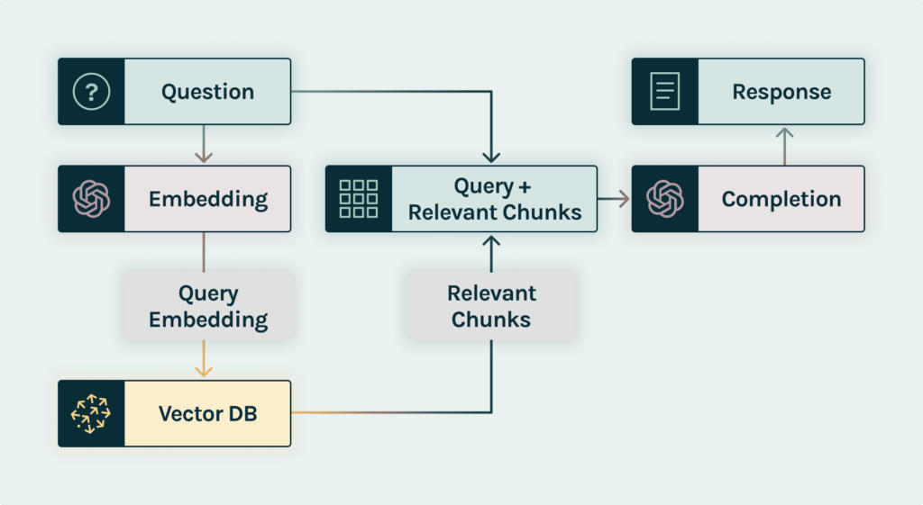
RAG

Slide 12
Pros and Cons
Pros:
Enhanced Data privacy
Flexibility and Customization
Accessible in offline(locally)
Cons:
Limited collaborative features
Complexity during initial setup
offline Limitations

Slide 13
Issues and solutions
Data Privacy Challenge: Make sure the Q&A Bot works locally.
Solution: Implement robust local data encryption as a solution.
Training with Diverse Data:Challenge: Train the bot using a variety of sources.
Solution: Curate balanced datasets; update training data on a regular basis.
Mapping Prompts to Trace Data Challenge: Record prompts and use a map to trace data.
Solution: Implement a systematic prompt recording system and apply traceability tools

Slide 14
Future Direction
In the future, the OnDemand Professor Q&A Bot will use Natural Language Processing (NLP) enhancements to increase understanding and replies. To improve the learning environment, integration with collaborative platforms, ongoing training with new datasets, and a user feedback system will be developed.
Mobile adaptability will increase accessibility, while continuing security measures, such as frequent audits, will keep the Q&A Bot at the forefront of network security education, responding to new trends and user demands.

Slide 15
Conclusion
In conclusion, the creation of the OnDemand Professor Q&A Bot was directed by a privacy-first strategy, assuring data protection by running entirely on the local workstation with effective encryption techniques.
The solution effectively handled problems such as source identification, effective training with varied data sources, and Wireshark data collection competence. The project ensures an efficient, safe, and well-informed learning experience for network security users by providing systematic mechanisms for mapping prompts to trace data.
Ongoing monitoring and improvement initiatives demonstrate our dedication to providing a dependable and privacy-conscious instructional tool.

Slide 16
References
References:Host a Llama 2 API on GPU for Free | by Yuhong Sun | Aug, 2023 | MediumGitHub - Chainlit/chainlit: Build Python LLM apps in minutes
How to Build a Multiple Choice Quiz with Chat GPT | by S713FF3N | Dev Genius
GitHub - VolkanSah/GPT-API-Integration-in-HTML-CSS-with-JS-PHP: A basic GPT conversation script designed to help you learn to interact with OpenAI's GPT technology. Includes best practices and a free security whitepaper.
How to create a private ChatGPT that interacts with your local documents – TechTalks
https://github.com/pathwaycom/llm-app.git

Slide 17


